Slide 1

BLACK PANTHERS PARTY
BLACK PANTHER PARTY
JOEY WONG
ON YING CHAN
By Joey and On Ying

Slide 2
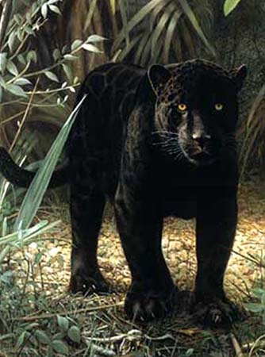
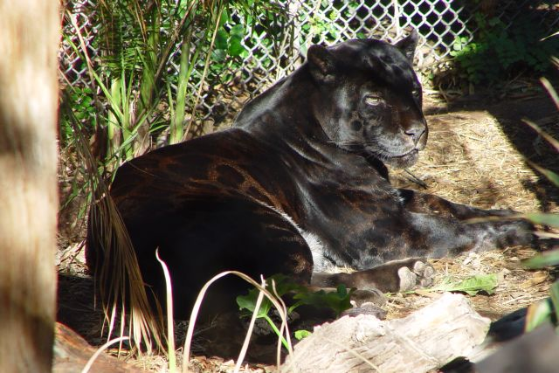
WHY DID THEY CHOOSE THE NAME
“BLACK PANTHER”?
The original name for the Black Panther was the Black Panther Party for self defense. The word “Black” was to show their nationality, and “Panther” was to show their power and strength.

Slide 3

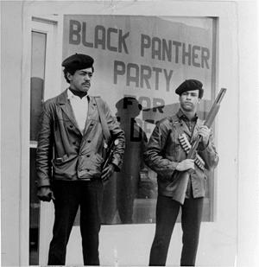
The word self-defense was added to separate the non-violent group which was protesting for the same thing at the time. (which was led by Martin Luther King at
the time)
Huey Newton and Bobby Seale
Leader of Black Panthers
Martin Luther King
Leader of the Non-violent group

Slide 4
WHY WERE THE BLACK PANTHERS FORMED?
The Black Panther Party for Self-Defence was formed in mid 1960s – 1970s for the freedom and equality of black people.
They were well known for their military behavior, their political and their
social flourishes.

Slide 5
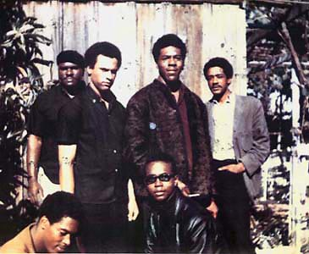
WHO WERE THE BLACK PANTHERS?
Huey P. Newton and Bobby Seale formed the Party of Black Panthers in the mid 1960s, he got some friends and the Panther Party rose.
Original Six
Black Panthers

Slide 6
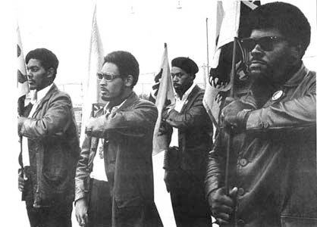
WHAT WAS THE BLACK PANTHER PARTY?
It was a group of blacks who formed a group and showed people how they should be treated with justice and fairly.
The Black panthers wanted to show people that they were powerful and strong. They also practiced military self defence.

Slide 7
THE BLACK PANTHER THEORY
The Black panther practices to be like Malcolm X because he represented both a militant revolutionary.
Malcolm X fought and stood up to win equality for all oppressed minorities.
He was like a hero to the Black panther party
The Black panthers followed Malcolm’s belief of international working class unity.

Slide 8

Huey Newton’s Arrestment
As the BPP was starting to spread and became known all around the world, Huey Newton was arrested in the 70s for alleged murder.
Immediately, a “Free Huey” campaign started, lead by Eldrige Cleaver. However, Huey Newton was only released until 1070s.
Eldridge Cleaver.
Leader of “Free Huey”
Campaign

Slide 9
THE TEN POINT PROGRAM
The Black Panthers had a program called the Ten Point Program, which is basically just the BPP’s goals.
This is the Ten Point Program:
We want power to determine the destiny of our black and oppressed communities' education that teaches us our true history and our role in the present day society.
We want completely free health
care for all black and oppressed
people.

Slide 10
We want an immediate end to police brutality
and murder of black people, other people of
color, and all oppressed people inside the
United States.
We want an immediate end to all wars of aggression.
We want full employment for our people.
We want an end to the robbery by the capitalists of our Black Community.
We want decent housing, fit for the
shelter of human beings.
We want decent education for our
people that exposes the true nature of
this decadent American society.

Slide 11
We want freedom for all black and oppressed people now held in U. S. Federal, state, county, city and military prisons and jails. We want trials by a jury of peers for all persons charged with so-called crimes under the laws of this country.

Slide 12

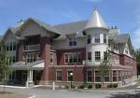


We want land, bread, housing, education, clothing, justice, peace, and people’s community control of modern
technology

Slide 13

THE END
BY ONYING AND JOEY

