Slide 1
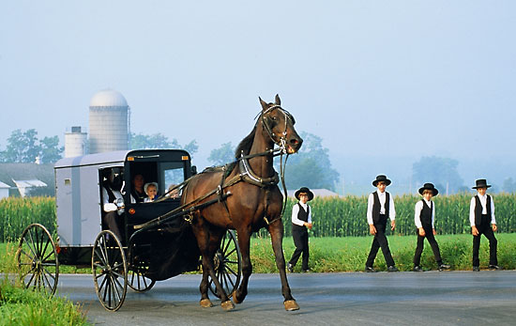
The Amish
By Mika Bridges & Kylie Cheung

Slide 2
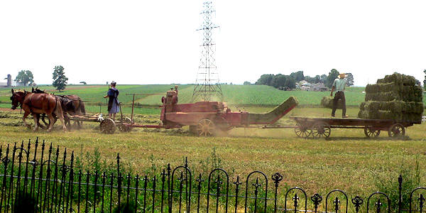
Introduction to The Amish
The Amish also known as Pennsylvania Dutch have simple lifestyles and are very old fashioned. They are usually farmers and never use electricity or automobiles etc.
Their transportation is the horse-drawn Carriage. Their wants are just everyday needs.
They never change or improve on anything. They do not care about latest trends and social status.
They do not rely on anyone else outside of their community.

Slide 3
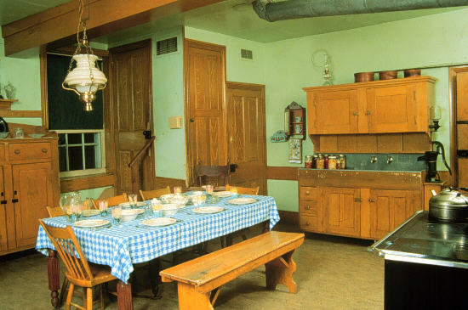
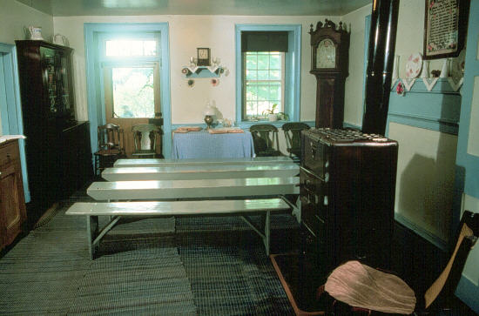
Their Lifestyles and Culture
They have a deep respect for God and each other.
Everything takes place at their homes. Children’s education, Amish church services, courtship, marriages, funerals, festivals……
Amish houses are plain and clean. They have simple vivid coloured furniture. Furniture is passed down from generation to generation.

Slide 4
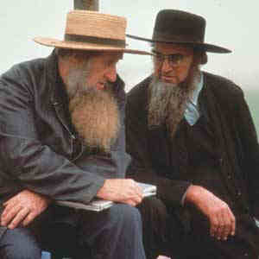
Their Rules
It is against their religion to pose for a photo.
Married men are not allowed to shave their beard, however, unmarried men must shave their faces.
If a man goes gay, they are cast out from the church and family.
Child Discipline
The Amish is very strict on the obedience in their children. Their children may pout or disobey a parents request. However, things like tantrums, making faces, calling each other bad names is very rare, because the children knows that this will result in Corporal Punishment.

Slide 5
Marriage
Amish teens are allowed to start courting when they turn 16.
A marriage will take place on either Thursday or Tuesday at their home, the day before the marriage everyone will come over for feast preparations for the next day.
The couple do not go on honeymoon as we do, they do not live together until they set up their house the following spring.
The Amish has no such thing as divorce. Once married the bond between husband and wife is more out of respect than love.

Slide 6
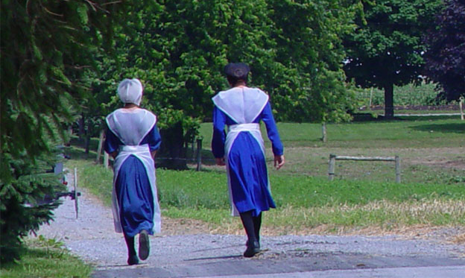
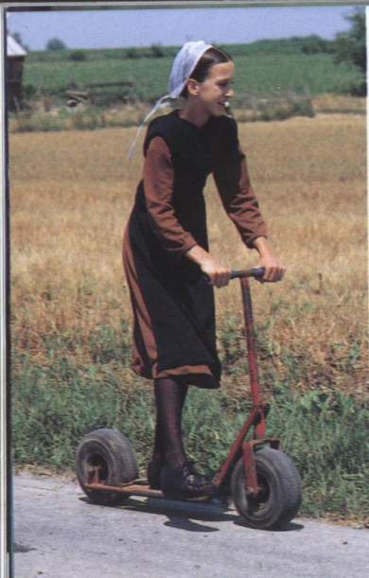
Their Clothing
Amish clothes are homemade and very plain. They are not allowed to use fancy buttons, zippers or Velcro, only straight pins and hooks are allowed.
Women must wear: plain-cut dresses with a solid colour, bonnets and shawls. Black or white aprons are worn at home and at church. They are not allowed to wear any jewellery.
Girls may wear coloured bonnets until age nine, older girls and women wear black bonnets.

Slide 7
Their History
The Amish sought refuge in Pennsylvania because they were being persecuted in Switzerland and Southern Germany.
Because The Amish were persecuted, they are reluctant to change and they have a distrust of those outside of their community.
The Amish were part of the Mennonites and they broke a way 250 years ago, but their customs, transportation, farming, and entertainments have changed very little.
The Amish were found in Europe by Jakob Ammann between 1693 and 1697.

Slide 8
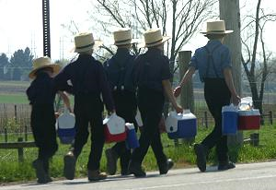
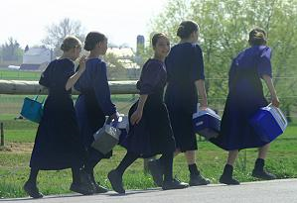
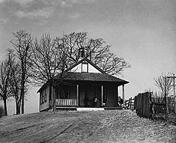
Education
The Amish do not educate their children past the eighth grade. Almost no Amish go to High School.
Once a girl has finished school she will learn sewing and cooking from the mother whilst the boy will learn farming and carpentry.
In most communities, the Amish operate their own schools, which is usually a one-room school houses with unmarried women as teachers from their own community.
There are some children who go to non-Amish public schools.

Slide 9
Bibliography
Books:
The Gentle People
By, James A warner, Donald M.denlinger
Websites:
http://en.wikipedia.org/wiki/Amish
http://www.800padutch.com/amishpeople.shtml
By Mika Bridges & Kylie Cheung

