Slide 1
Leaning into the afternoons

Slide 2
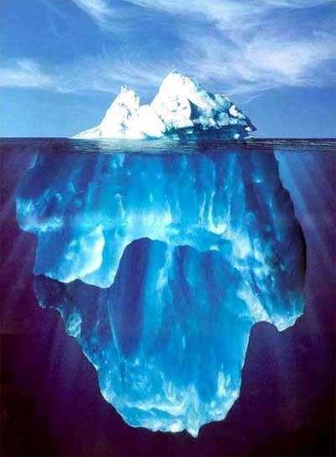
Leaning into the afternoons I cast my sad nets towards your oceanic eyes

Slide 3

There in the highest blaze my solitude lengthens and flames, its arms turning like a drowning man’s

Slide 4
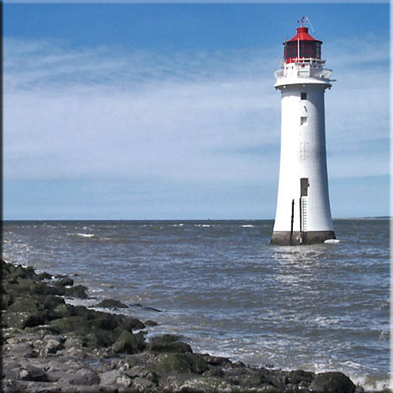
I send out red signals across your absent eyes that move like the sea near a lighthouse

Slide 5
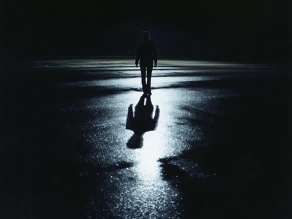
You keep only darkness, my distant female, from your regard sometimes the coast of dread emerges

Slide 6
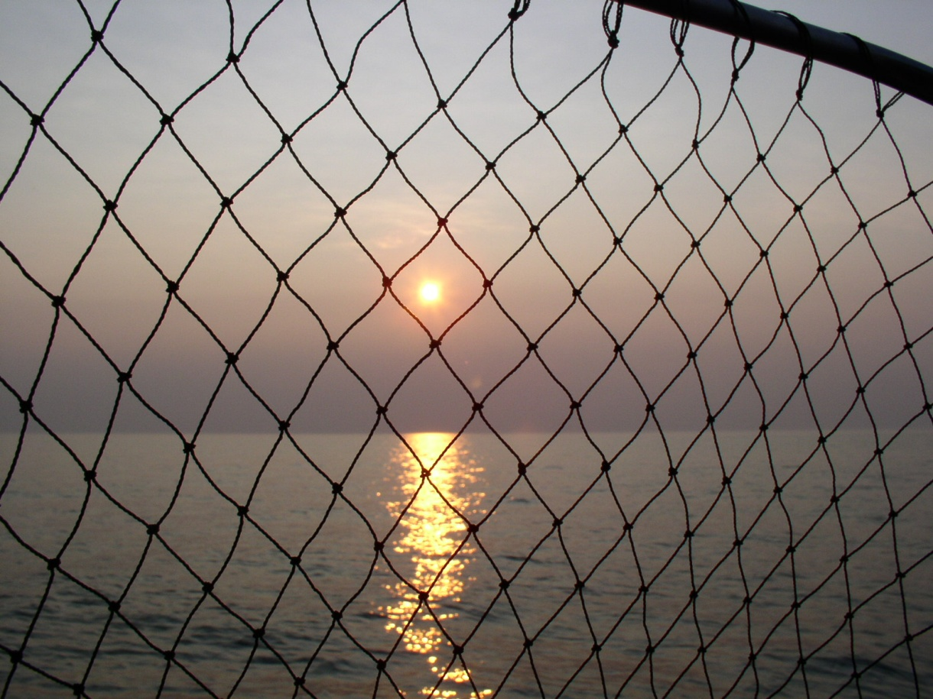
Leaning into the afternoons I fling my sad nets to that sea that beats on your marine eyes.

Slide 7
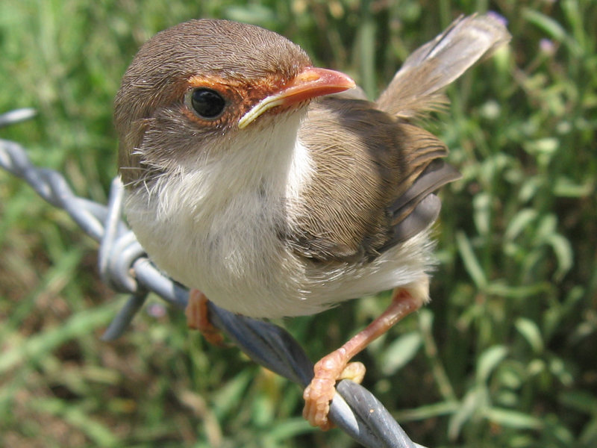
The birds of night peck at the first stars that flash like my soul when I love you

Slide 8
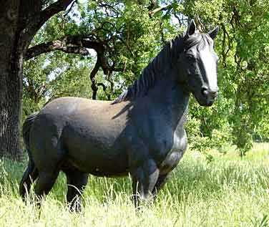
The night gallops on its shadowy mare shedding blue tassels over the land

