Slide 1
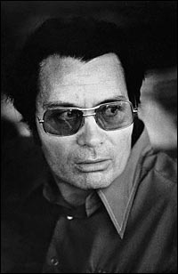
Jim Jones and
The People’s Temple
By: Chloe Ngan and Carolyn Ching
8M2

Slide 2
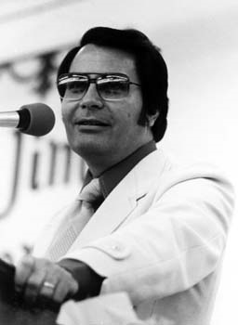
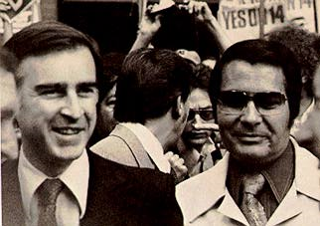
Early Life
James Warren Jones, aka Jim Jones, born May 13, 1931, Crete, Indiana, U.S.A
Started the People’s Temple when 19

Slide 3
Early Life (continued)
There were claims of Jones being a very weird child who was obsessed with religion and death at an early age
It was even said that he held frequent funerals for small animals and had purposely stabbed a cat to death
Jones studied about different religious leaders and took note of their strengths and weaknesses
Jones graduated from Richmond High School with honors in December 1948
Jones married Marceline Baldwin, a nurse, when he was 18

Slide 4
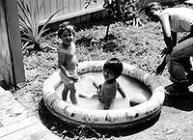
Children
Jones and his wife adopted eight Korean and black children and called this his “Rainbow family”
Jones also encouraged other Temple members to adopt orphans
This was an example of his protest against racism
They had their only biological son, Stephan Gandhi Jones in June 1959

Slide 5
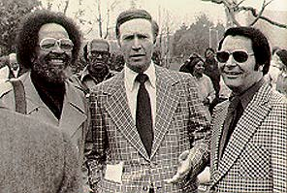
Religious Beginnings
Jones interest in religion began during early childhood because he found it hard to make friends
When he was 21 he was a student pastor at Sommerset Southside Methodist Church but left because the leader was racist
Jones eventually began his own church called the People’s Temple Christian Church Full Gospel
To raise money for his church he sold pet monkeys

Slide 6
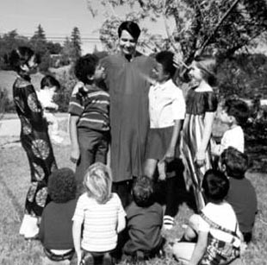
History and Influence
The People’s Temple was founded in 1955
The original name of the church was ‘Wings of Deliverance’ . This was later changed to ‘The People’s Temple’
The People’s Temple spread from Redwood Valley to San Francisco and Los Angeles

Slide 7
History and Influence (continued)
Jones also opened food kitchens and day-care centers
Temple members called Jones ‘Dad’
Jones had accumulated quite a lot of political power. Jones was invited to a number of political events, through which he was able to share his opinions with the public
His ideas seemed to represent a democratic future for some people

Slide 8
The ‘Promised Land’
Jones later moved the Peoples Temple to Redwood Valley, California which he believed was the ‘promised land’
Jones invited his followers to move to their new home, though some stayed in Indiana
The people who followed Jones to California sold all of their property and gave their money to the church. This showed that they trusted Jones a lot as they were dependent on the church

Slide 9
Sexual Affairs
Jones’s young women followers seemed to consider it a honour to help ease his sexual cravings, which he claims helped him gain more power
Jones claimed he had amazing sexual endurance
Male members of the Temple were also encouraged to sleep with Jones
Jones sometimes forced members to have sexual affairs with other Temple members
Jones banned all sexual contact with outsiders but said sexual relations between members were acceptable. However, these needed specific approval beforehand

Slide 10
Punishments
Beatings were common for minor offenses
Jones was hard on any male who was interested in a girl that he fancied
Those who were good in Jones’ eyes were given special privileges
Children were also beaten and harshly treated for minor lacks of discipline

Slide 11
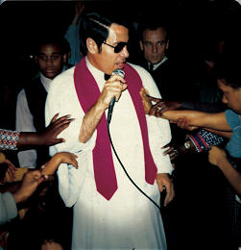
Mental Deterioration
Jones became paranoid and once claimed he killed a burglar who tried to break into his hut. He claimed to cook the man’s flesh in a stew which he gave to his followers
Jones spent more and more time in his hut taking drugs and listening to news
Jones also controlled what his followers were listening to on the radio

Slide 12
Suicide Rehearsals
Jones wanted to test his followers’ loyalty by asking them to drink poison. Jones created a series of suicide rehearsals which he called ‘White nights’
During the first test, some resisted and ran away. However, after the shooting of a member they quietly obeyed
Jones later told them that it wasn’t actually poison and thanked them for testing it for him
Every time the members would be told they were drinking poison, but they were never sure
They gradually got used to the idea of giving up their lives for Jones

Slide 13
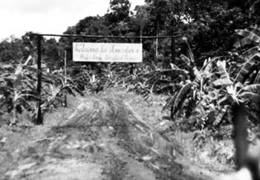
Jonestown and the end of The People’s Temple
The People’s Temple was relocated to Jonestown, Guyana
Armed guards were posted around the People’s Temple to protect it from attack. This was actually an excuse to stop the members from escaping
In 1978 Temple members were told the Guyanese Defence Force was going to attack because of alleged shoots of a US congressman pilot by a member

Slide 14
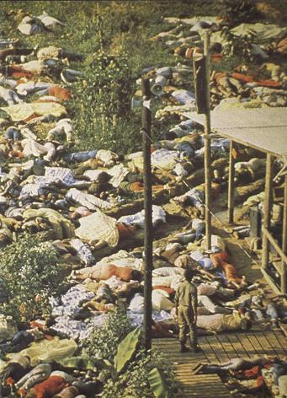
Jonestown and the end of The People’s Temple (Continued)
Jones said they would not surrender and should kill themselves instead and die of dignity. His followers were assured that they would ‘meet again in another place’
Jones shot himself in the head with a pistol after his followers killed themselves with poison. He was 47.

Slide 15
Bibliography
Book
Cawthorne, Nigel The Worlds Greates Cults 1999
Websites
“Wikipedia”
<http://www.wikipedia.org>
“The People’s Temple” <http://www.caic.org.au/biblebase/apocolyptic/jones.htm>

