Slide 1
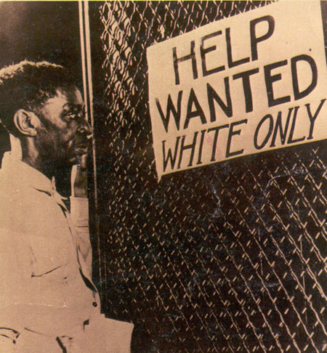
Jim Crow Laws
By Emily Cheng
Gunjan Bhargava and
Maddy Wozencroft 9S

Slide 2
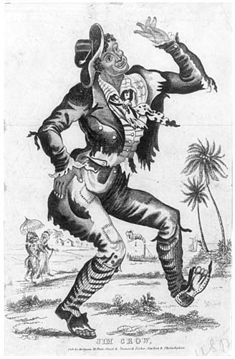
“Jim Crow”
The name Jim Crow was inspired by the song and dance 'Jump Jim Crow'. This was done in 'blackface' by the white comedian Thomas Dartmouth, and played as a mockery to African-Americans. Because of the fame of this song, by 1838, the term Jim Crow was used commonly as an adjective to describe African-Americans

Slide 3
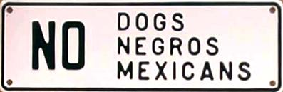
The Origins of Jim Crow
After the ‘Reconstruction’ period, 1865-1877, when the African-Americans finally regained their rights, there was still a lot of racial tension. The southern, ‘racist’ whites did not like the way things were and sought to change back to the old ways.

Slide 4
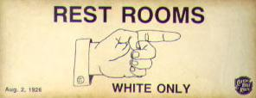
Segregation of Public Areas
The Jim Crow Laws were enacted between 1876 and 1965. These laws segregated all public facilities with the motto, “Separated but equal” for all black African-Americans. These included public restrooms, restaurants, schools, transportation and even the military.

Slide 5
To Vote or not to Vote?
Although blacks officially had the right to vote and be elected to office, many whites resented this, and therefore created new ‘laws’ which required blacks to take many tests, such as literacy tests in order to vote. Some whites even used violence, attacking blacks when they neared the voting stations. This left the illiterate majority of the African-American population illegible to vote, their interests left overlooked.

Slide 6
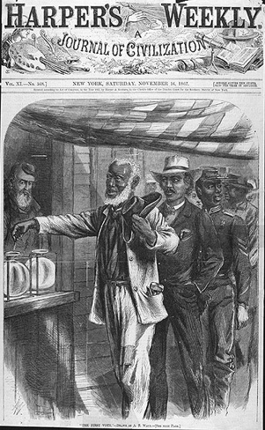
To Vote or not to vote?
This is a picture drawn during the Reconstruction Period, depicting both blacks and whites being able to vote. However, this did not happen as the whites used many different methods to prevent blacks from voting

Slide 7
Separated but ‘Equal’?
Despite Jim Crow legal pretense that the races be "separate but equal" under the law, the actuality was that non-whites, such as Negros and Mexicans, also known as ‘Coloreds’ would be given inferior facilities and treatment. Negro schools were underfunded but none of the blacks could have a say about this.

Slide 8
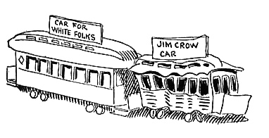
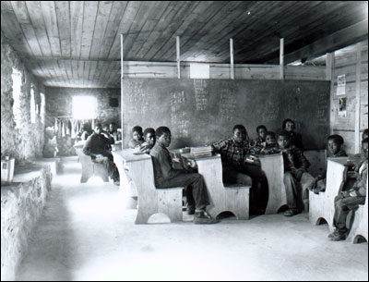
Separated but ‘equal’?
The cartoon depicts the difference between a train car for whites and the ones for blacks.
Below is a picture of a Negro public school

Slide 9
The Fight Against Jim Crow
The fight against Jim Crow was sparked by a black woman, Rosa Park’s refusal to give up her seat on the bus to a white man. This was the controversy which sparked the beginning to the numerous boycotts against segregation, including the infamous Montgomery Bus Boycott led by Martin Luther King Jr.
These demonstrations achieved positive results and helped spark political activism.

Slide 10
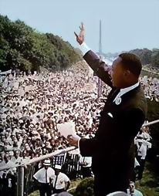
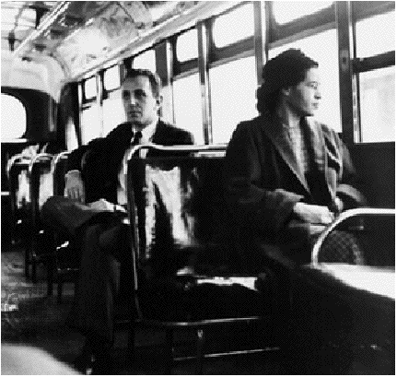
The fight against Jim Crow
Martin Luther King Jr. Giving his ‘I Have a Dream’ speech.
Rosa Parks, the woman who refused to give up her seat to a white man

Slide 11
The End of Jim Crow
In January 1964, President Lyndon Johnson met with civil rights leaders. He pushed Congress to pass the Civil Rights Act of 1964.
On July 2, President Johnson signed the historic legislation. It outlawed all discrimination in public accommodations (privately owned restaurants, hotels, and stores, and in private schools and workplaces). This was the end of Jim Crow.

Slide 12
Thank You For Watching
“I have a dream that one day this nation will rise up and live out the true meaning of its creed: "We hold these truths to be self-evident, that all men are created equal.“
- Martin Luther King Jr.

