Slide 1
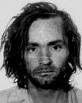
Charles Manson
Isabel Chan 8M2

Slide 2
Childhood
Born in 12th November, 1934 in Cincinnati, Ohio, United States as ‘No Name Maddox’
Kathleen Maddox was 16 years old and unmarried when she gave birth to Manson
Three weeks later, he became ‘Charles Milles Maddox’
His mother then married William Manson several years later and became ‘Charles Milles Manson’
Kathleen was an alcoholic, she sold Manson to a waitress for a pitcher of beer once and his uncle collected him a few days later

Slide 3
Childhood
1939, he lived with his uncle and aunt in McMechen, Virginia when his mother and her brother was imprison for 5 years
1944, she retrieved Manson and lived with him in run-down hotel rooms
1947, she tried to put him in a foster home but there was no home available
She then sent him to Gibault School for Boys in Terre Haute, Indiana
10 months later, he fled back to her but she rejected him

Slide 4
First Crime
After his mother’s rejection, he got cash to rent a room by burgling a grocery store
He then burgled a series of other stores
He was caught and sent to Indianapolis Juvenile Centre when he was stealing a bike
He escaped one day later and got recaptured
He was then sent to Boys Town and escaped four days later with another boy
They both committed two robberies on their way to the other boy’s uncle’s house
Caught during a grocery store break-in
Age 13, sent to Indiana School for Boys and got sex abused

Slide 5
First Crime
1951, he escaped with two other boys
The three boys were then caught driving stolen cars to California
He was sent to National Training School for Boys, Washington
After 4 years of schooling, his I.Q. was 120
"He was, the caseworker concluded, aggressively antisocial”

Slide 6
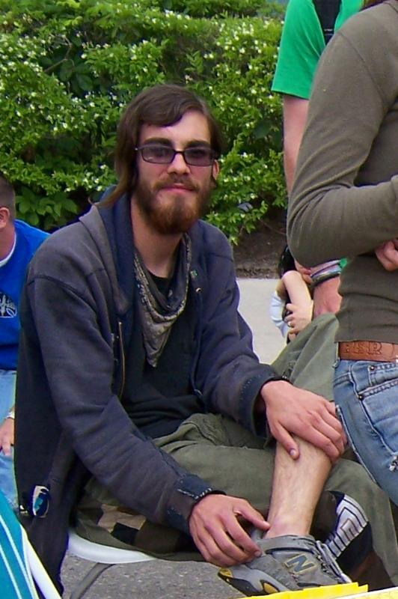


Children
Charles Manson Jr (Rosalie Jean Wills)-left
Charles Luther Manson (Leona)-middle
Valentine Michael Manson (Mary Brunners)-right

Slide 7



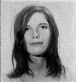
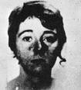

Manson’s “Family”
Charles Manson
Susan Atkins
Patricia Krenwinkel
Manson renamed her “Katie”
Leslie Van Houten
Charles Watson
Manson renamed him “Tex”
Lynette Fromme
Manson renamed her “Squeaky”

Slide 8
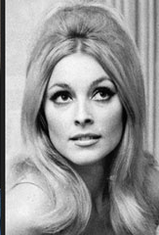
Murders
Sharon Tate
26 years old
Polanski (husband) was out of the
country
Two weeks shy of giving birth
Stabbed 16 times by Manson,
Susan Atkins, “Katie” and “Tex”
Sharon begged the killers to let
her baby live
Was murdered in her house

Slide 9
Charges
Conspiracy and Murder
Penalty
Reduced by abolition of death penalty to life
in prison which actually makes him happy
because ‘prison had become his home’
Juan Flynn, a Spahn Ranch worker said
“Charles Manson got away with everything. People will say, 'He's in jail.' But Charlie is exactly where he wants to be”

Slide 10
Bibliography
Book
CAWTHORNE, Nigel The World’s Greatest Cults 1999
Online Encyclopedias
Wikipedia < www.wikipedia.com >

